Slide 1
CS 416 Web Programming Intro to servlets
Dr. Williams
Central Connecticut State University

Slide 2
What is a servlet
Servlet is a Java class that extends capability of the server that hosts the website
Servlets can respond to requests and generate responses
Base class of all servlets is javax.servlet.GenericServlet which is protocol independent javax.servlet.http.HttpServlet is base for those using the HTTP protocol

Slide 3
Servlet methods
To be useful a servlet must implement one or more of the 4 HTTP request types by overriding these methods all of which take 2 arguments
(HttpServlet request, HttpServlet response)
GET – doGet(…)
POST – doPost(…)
PUT – doPut(…)
DELETE – doDelete(…)
The names are rather intuitive for once ☺

Slide 4
doGet and doPost
With a servlet the doGet() method gets called anytime a user
Enters the URL directly
Clicks on a link to a page
From a form submission of method=“GET”
The doPost() method gets called
From a form submission of method=“POST”

Slide 5
Developing a simple servlet
Go to New Project, in the dialog select new web application
This creates an application that when run will start Apache (web server) and GlassFish (application server)
Right click on the source packages folder and select New=>Servlet

Slide 6
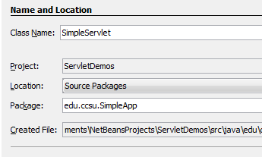
Create SimpleServlet
Press finish

Slide 7
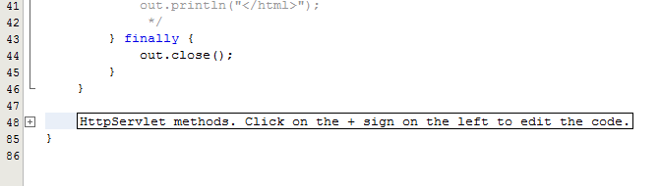
Changing the code
Netbeans creates a skeleton of the code for you, you just need to add your own code or overwrite the shells
At the bottom of the generated code there is a button to expand HTTPServlet methods, expand it

Slide 8
Changing doGet
By default doGet calls processRequest, we want to change that do our own code so delete it out
Within our function we have two arguments the request and the response
Request allows us to read the information being sent to our form
Response is how we write the response

Slide 9
Changing the response
First tell the response that we are going to be writing out HTML
response.setContentType("text/html");
Next we use a PrintWriter to write to the response
PrintWriter writer = response.getWriter();
After that we can write any HTML we want to the output page
writer.println("<h1>Hello from my servlet </h1>");

Slide 10
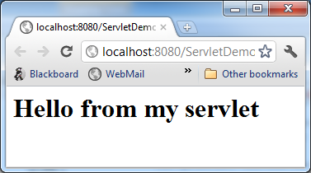
Testing our servlet
To test that our servlet works right click the file in the project and select Run file
This will start up Apache and Glassfish (if they are not already started) and deploy your servlet and you should get

Slide 11
Using form GET
If we create a form that GETs from our servlet
Input name:
<form action=“SimpleServlet” method=“GET”>
name<input type=“textbox” name=“name” />
<input type=“submit” value=“Submit” />
</form>
When we hit submit it calls doGet on the servlet

Slide 12
Reading parameters
Within a doGet or doPost the way you access input variables being sent to the server are through the request’s getParameter method which returns a string with that parameter’s value
If it is an input where more than one value can be selected you would use getParameterValues which returns an array of Strings

Slide 13
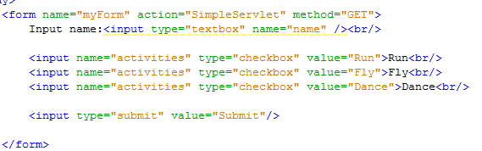
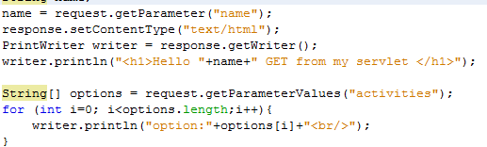
Reading parameters

Slide 14
doPost
To do the same thing for a POST method you would use the exact same code as the GET, this way if the form instead used method=“POST” your servlet could handle it
Frequently you will have the same handler for both (the processRequest method that was added by NetBeans in the beginning)

Slide 15
Request forwarding
Request forwarding allows a servlet to perform some processing on the request before forwarding it to another servlet for additional processing
Example: one servlet handles augmenting the request the second works on processing the complete data fields
One handles charging the account another handles shipping

Slide 16
Request forwarding cont.
In addition to doing processing on its own a servlet is able to add additional information to the request before sending it on
request.setAttribute("somename",myClass);
It can then forward it on to the next Servlet to process it

Slide 17
Request forwarding
After the initial servlet is done processing the request and adding information on the request it can forward the enhanced request using:
request.getRequestDispatcher( “SecondServlet”).forward(request,response);
From the second servlet’s perspective it is just as if it was called directly just additional information may be available
To the user they are unaware that multiple servlets may have been involved

Slide 18
Demo
Form is posted to a servlet
Initial servlet inspects passed name if possible it enhances it with names of other family members (such as an interaction with a database)
Second servlet uses enhanced information to display content to the user

Slide 19
Initial servlet
protected void processRequest(HttpServletRequest request, HttpServletResponse response)
throws ServletException, IOException {
response.setContentType("text/html;charset=UTF-8");
PrintWriter out = response.getWriter();
try {
String name;
name = request.getParameter("name");
List familyMembers = new ArrayList();
familyMembers.add(name);
if (name.equals("Chad")) {
familyMembers.add("Grace");
familyMembers.add("Kate");
familyMembers.add("Patti");
} else if (name.equals("Jon")) {
familyMembers.add("Jane");
}
request.setAttribute("family", familyMembers);
request.getRequestDispatcher("PrintFamilyServlet").forward(request, response);
} finally {
out.close();
}
}

Slide 20
Second servlet
protected void processRequest(HttpServletRequest request, HttpServletResponse response)
throws ServletException, IOException {
response.setContentType("text/html;charset=UTF-8");
PrintWriter out = response.getWriter();
try {
response.setContentType("text/html");
PrintWriter writer = response.getWriter();
writer.println("<h1>family</h1>");
List family = (List)request.getAttribute("family");
for (int i=0;i<family.size();i++){
writer.println(family.get(i) +"<br />");
}
} finally {
out.close();
}
}

Slide 21
Response redirection
One disadvantage of request forwarding is request can only be forwarded to JSPs/Servlets in the same application server
Response redirection allows a servlet to do some sort of processing of the request before redirecting the user to another page

Slide 22
Response redirection
The initial servlet is able to do some processing before redirecting the user to some other site:
request.sendRedirect(url);
From the redirected site’s perspective the url being directed to is as if it is coming from the user directly
From the user’s perspective they will receive a response as if they typed in a different URL

Slide 23
Response redirect Servlet
protected void processRequest(HttpServletRequest request, HttpServletResponse response)
throws ServletException, IOException {
response.setContentType("text/html;charset=UTF-8");
PrintWriter out = response.getWriter();
try {
String url = request.getParameter("website");
if (url!=null&&url.length()>0){ response.sendRedirect("http://"+url);
}else{
out.println("<h1>No website specified</h1>");
}
} finally {
out.close();
}
}

Slide 24
Hands on
Create your own servlets for
Create a form that has a series of options (maybe pizza toppings) in the form of check boxes plus submit button to POST the form
Your servlet should read the values selected and put them in to a TreeSet and add them to the request then forward to your second servlet
Your second servlet should output the pizza toppings selected in alphabetical order

